Slide 1
Design Rule 13 June 2024

Slide 2
problems:
2 comments
A1.c_d {
@A1.c: Min enclosure of A1 region over contact region must be >=0.004um
@A1.d: Min enclosure of A1 line end region beyond contact region must be >=0.05um
parameter setting need add a voltage.

Slide 3
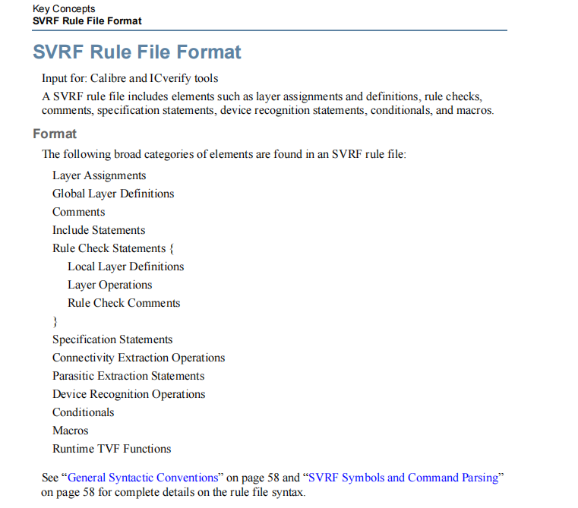

Slide 4
GT

Slide 5
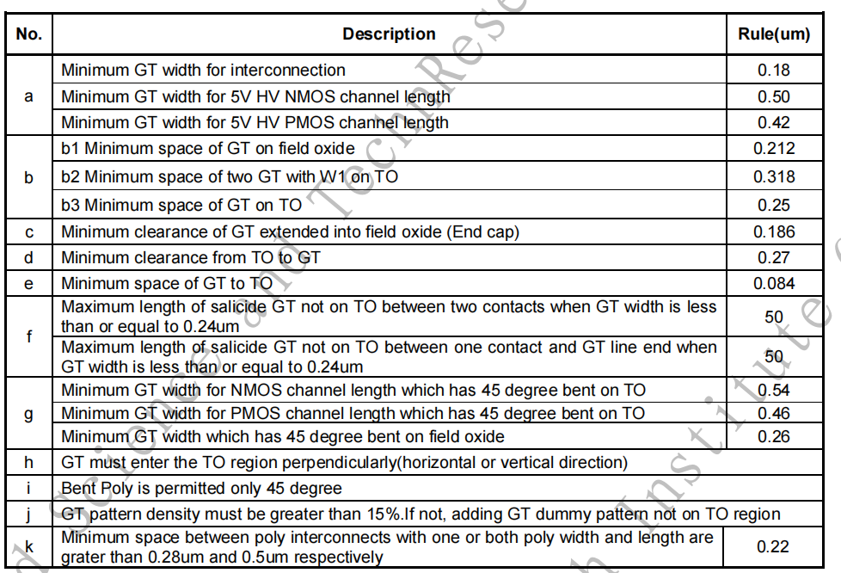
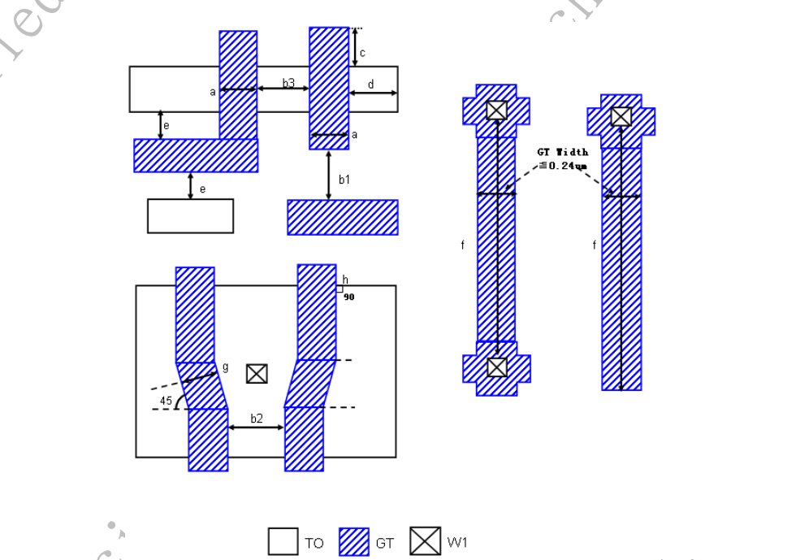
C153

Slide 6
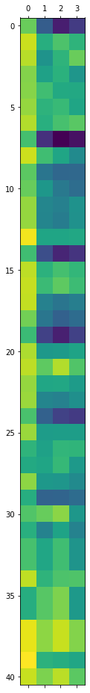
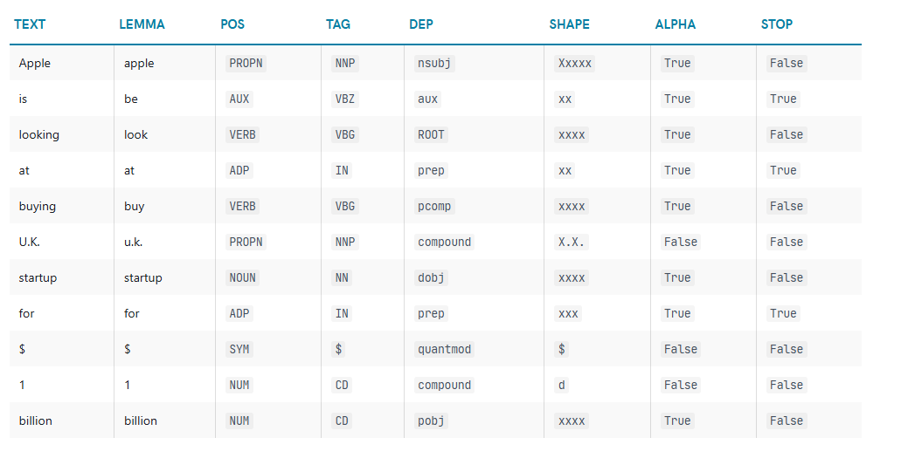

Slide 7
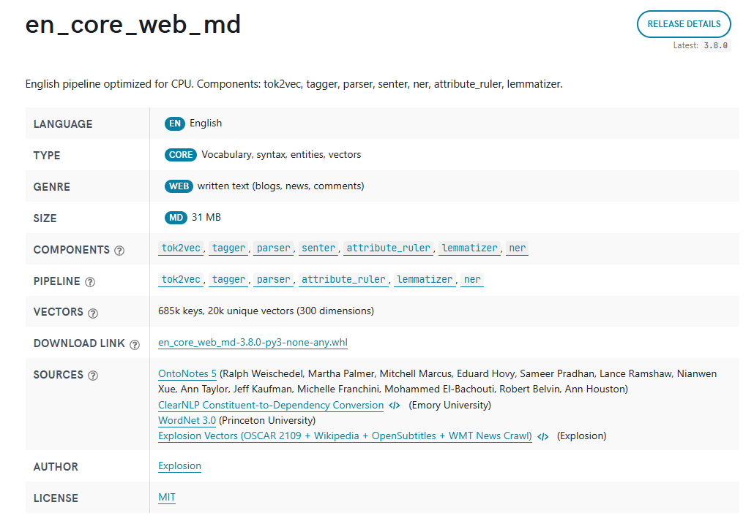
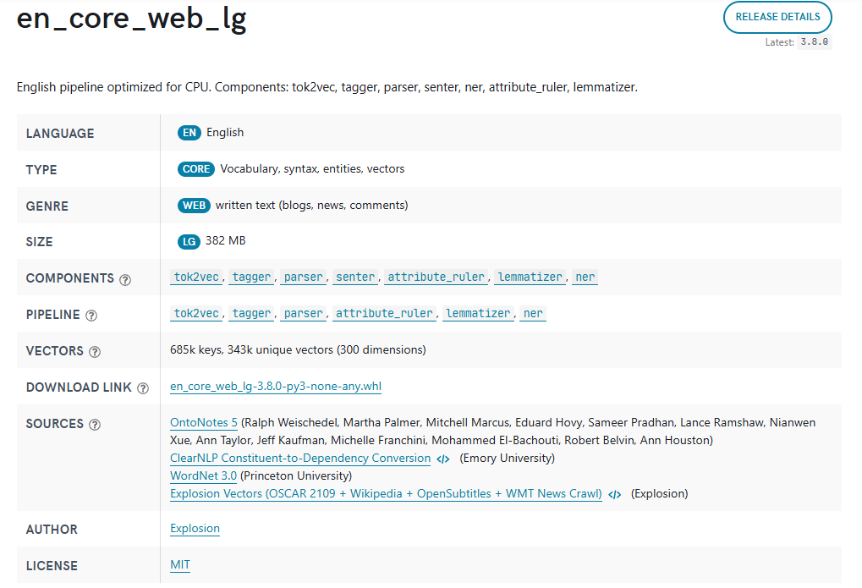
Trained language models

Slide 8
Problem1
: Min width for interconnects must be > 0.18 [0.8392012460844951, 0.7714454568248105, 0.6473778953714371, 0.7819062697891819, 0.7387038307675349]
: Min width for gate of HVNMOS(5.0V) must be > 0.5 [0.8267204272259129, 0.7258958170850318, 0.7159109785578989, 0.7944487208798044, 0.7442673432178853]
: Min width for gate of HVPMOS(5.0V) must be > 0.42 [0.8267204272259129, 0.7258958170850318, 0.7159109785578989, 0.7944487208798044, 0.7442673432178853]
: Min spacing between two GT region must be > 0.212 [0.6670636140444159, 0.6299000543152923, 0.6067157229864958, 0.6878160704742684, 0.6462152889429108]
: Min spacing between two GT regions with contact on active area must be > 0.318 [0.6464538823379467, 0.6329985546878784, 0.6495425026243955, 0.7018356835683799, 0.5286595113485515]
: Min spacing between two GT regions without contact on active area must be > 0.25 [0.6515929084470056, 0.6355369725159173, 0.6305697220454486, 0.6923949699816553, 0.5286264333408195]
: Min extension of poly end cap must be > 0.186 [0.6606213301900746, 0.6095412533194965, 0.7084792442663884, 0.7624389911151069, 0.5939517552735063]
: Min extension from active to GT must be > 0.27 [0.6259122045110923, 0.5741520174066392, 0.5781508914239334, 0.648836426264981, 0.606426715644066]
: Min spacing of poly to active must be > 0.084 [0.6918527542539037, 0.6546297074654823, 0.7339843052426148, 0.7960312010762545, 0.6088380360288511]
1: Max length of salicide poly on SAB between two contacts must <=50 when poly width is less than or equal to 0.24 [0.6916189054375528, 0.6554015216054323, 0.7833998119704058, 0.8018500597244714, 0.5923963995949967]
: Min GT width for NMOS channel length which has 45 degree bent on TO must be > 0.54 [0.7356228806513149, 0.6838137234084299, 0.6855714556665286, 0.7439526298856629, 0.6084137545571904]
: Min GT width for PMOS channel length which has 45 degree bent on TO must be > 0.46 [0.7356228806513149, 0.6838137234084299, 0.6855714556665286, 0.7439526298856629, 0.6084137545571904]
: Min GT width for channel length which has 45 degree bent on field oxide must be > 0.26 [0.7306065333843937, 0.697118533160439, 0.71921131780789, 0.7637408486916082, 0.6011398453331901]
:GT must enter the TO region perpendicularly(horizontal or vertical direction). [0.7294977889824542, 0.6983467720318964, 0.6848318446146171, 0.7254918913410936, 0.5884237759431691]
: 90 degree bend on active region is not allowed [0.6340597950894702, 0.6085128546106842, 0.6396482589924125, 0.6787800418869301, 0.4465974423487845]
: Min space between poly interconnects with one or both poly width and length [0.7492361833248683, 0.7576965962764084, 0.861621960435455, 0.8946965589614642, 0.4969072486008574]

Slide 9
Problem 2
Windows fatal exception: access violation
Main thread:
Current thread 0x00000970 (most recent call first):
右击“我的电脑”。单击“属性”。
在“系统属性”中单击“高级”。
在“性能”中单击“设置”。
在“性能选项”中单击“数据执行保护”。
单击“添加”。选择要运行的程序。
OK。就这么简单。

